Slide 1

National Registry – Design Document
User Registration

Slide 2


User Registration – Process Flow
New User Registration
Registration Application
Document Upload
Fee Payment
Project Proponent
Review Applications
User Database
Rejected/Modify/Delete
Approved
Article-6 Secretariate/ ITMO Registry Administrator

Slide 3
User Management
User Registration Microservice
Functions:
User Registration
Forgot Password
UI/UX
User Registration form
Forgot Password form
User profile
User List & delete/reject/approve user
Database – as per UI/UX forms

Slide 4
Activity 1 - User Registration
User Registration UI/UX submit
User Reg MS
Database
Check user in database
If user doesn’t exist – create user and send mail notification to user and approver; alert successful submission and return login page. Create user profile page
If user exists – alert error response to user and return login page

Slide 5
Activity 2 – Forgot Password
Forgot Password - UI/UX submit
User Reg MS
Database
Check user in database
If user doesn’t exist – alert error response to user and return login page
If user exists – email notification with reset password link. Reset password and store new password in database

Slide 6
Activity 3 –Modify user profile
User Profile - UI/UX submit
User Reg MS
Database
Update user details
Name, Contact No. and password can be updated – refer the excel sheet

Slide 7
Activity 4 –User List
User List - UI/UX submit
User Reg MS
Database
Update user status
Manual Fee Payment status update by approver to yes (default value is No)
Approve/reject/delete user
Default status is pending approval
If user status is pending approval, action would be Approve/Reject with icons
On Approve action, status to change to Approved
If user is approved, action would be delete
On reject/delete, user to be removed from the user list and status updated to rejected/deleted in database

Slide 8
Activity 5 –Login to Global System
User Reg database
Global System
User Database
Expose login API with user database, credentials and access rights to Global system

Slide 9
Registry – Design Document
Project Database

Slide 10
Activity 1 –Replicate Project Database
Global System
Project Database
Project Database
Expose fetch project database from Global system and arrange as per the agreed format. Filter projects as per user rights. e.g.,
Project proponent/ Bi lateral partner – projects associated with user email
Project Url to redirect to project page on Global System

Slide 11
Registry – Design Document
ITMOs Issuance

Slide 12


ITMO-Issuance
DoCC/NAB Login to ITMO Registry
Select Project – Requesting Issuance
DoCC/Approver 1
Approved
ITMO Registry Update
Article-6 Secretariate/ ITMO Registry Administrator
Final Approver/NAB/ Bilateral Partner Review
ITMO Registry
Approved
ITMOs Issuance Certification
Bilateral Partner Coordinator

Slide 13
Activity 1 –Recommend
Project Database
ITMOs repository
Project Database
Filter Projects as per the rules in the excel sheet
Select project from dropdown and fetch the information as per the table refer (Project List – Issuance Recommed tab):
DoCC recommend ITMOs issuance (yearly basis) and send for approval
Update status on ITMOs repository at each stage
ITMOs issuance statuses:
Pending Approval
Recommended for Issuance (after DoCC approval)

Slide 14
Activity 2 –Approve
ITMOs repository
ITMOs repository
ITMOs repository
Access project through my approvals screen
Select project from dropdown and fetch the information as per the table (refer Project List – Issued tab):
Final Approver approves ITMOs issuance (yearly basis)
Update status on ITMOs repository
Create unique id for ITMOs issued
ITMOs issuance statuses:
Issued (after approving agency approval)

Slide 15
Registry – Design Document
ITMOs Transfer

Slide 16
ITMO-Transfer
User/DoCC/NAB Login to ITMO Registry
Select Project – ITMOs Issued
Project Proponent
Request for transfer
ITMO Registry Update
Article-6 Secretariate/ ITMO Registry Administrator
Final Approver
ITMO Registry
Approved
ITMOs Transfer
Bilateral Partner Coordinator

Slide 17
Activity 1 –Request for transfer
ITMOs repository
ITMOs repository
ITMOs Database
User get filter Projects with project status as issued
Select project from dropdown and fetch the information as per the table (refer Project List – Transfer tab):
User requests ITMOs transfer/retiral and send for approval (refer Transfer – Request tab);
Allocate ITMOs Id for the request
Update status on ITMOs repository
Status:
Pending

Slide 18
Activity 2 –Approve
ITMOs repository
ITMOs repository
ITMOs repository
Approver - List Projects with status as pending
Populate project list as per the table (refer Transfer – Approve tab);
Approver approves ITMOs transfer/ retiral (yearly basis)
Update status on ITMOs repository
Create ITMOs transfer/ retiral certificate
Status:
Completed

Slide 19
Registry – Design Document
GHG Accounting and Adjustment

Slide 20
GHG Accounting
GHG Accounting
Upload and read GHG Inventory data (excel) as per defined format; e.g.
Create GHG Accounting Report – combination of uploaded excel and ITMOs transfer data. Will be finalised during the assignment. e.g.
Year | GHG Inventory
Year 1
Sector 1 data
Sector 2 data
Year | GHG Inventory | ITMOs Transferred | Net GHG Emission
Year 1
Year 2
Year 3

Slide 21
Registry – Design Document
ITMOs Reports/ Summary

Slide 22
ITMOs reports
ITMOs Database
ITMOs dashboard for all the projects in the system
Create ITMOs reports based on
Project wise ITMOs issued and transferred
Agency wise ITMOs issued and transferred
Sector wise reports
Project type wise reports
And any other combinations
Dynamic visualisations to be made available for each reports

Slide 23
National Registry Process (Yellow Highlighted)
Step-0: Registration of Project Proponent
Step-0.1: Submission of Registration Application on Portal and User Fee Payment
Step-0.2: Project Proponent/new user approval by the Article 6 Secretariat
Step -1: Submission of ITMO Project Idea Note (PIN)
Step -2: Screening of ITMO PIN
Step-2.1.1: Unique ITMO Project Identification Number Generation and Enlisting of approved ITMO PIN in ITMO Registry
Step-2.2.2: Issue of Authorization Letter (LOA) by the Article 6 Secretariat
Step -2.2: LOA for ITMO project by bilateral partner (e.g. Switzerland) or for any other certification pathway (If required )e.g. voluntary carbon market)
Step -3: Submission of ITMO Design Document (ITMO DD)
Step -4: Third Party Validation of the ITMO-DD
Appointment of VVB for Validation (by Project proponent)
Document submissions for validation
Validation as per defined rules, guidelines and standard auditing practices and submission of final documents on ITMO Registry portal
Step -5: ITMO project Registration Review
Step-5.1: Registration Review by Secretariat including presentation to Article 6 Secretariat by PP for registration review and NAB approval
Step-5.2: Registration Review by bilateral buyer (if required)
Step -5.3: Registration of ITMO Project and updated on ITMO Registry

Slide 24
ITMOs Project Implementation Process
Step-6: ITMO Project Implementation and Monitoring
Step-6.1: Step 6.1 – ITMO monitoring update on iMRV Tool
Step-6.2: Preparation and submission of ITMO Monitoring Report (ITMO-MR)
Step -7: Verification through VVB
Appointment of VVB for ITMO Verification (by Project proponent)
Document submissions for verification
Verification as per defined rules, guidelines and standard auditing practices and submission of final documents on ITMO Registry portal
Step -8: Performance Review by Article 6 Secretariate and by bilateral buyer(s)
Step-8.1: The ITMO Issuance/Performance Review by bilateral buyer(s)
Step-8.2: Internationally Transferred Mitigation Outcomes (ITMOs) Certification
Step -8.3: Issuance of ITMOs Certificate for ITMO project and updated on ITMO Registry
Step -9: ITMO sales/transaction and settlement with bilateral buyer (as applicable) as per the bilateral agreement and ITMO purchase agreement
Step-9.1: Deduction of Share of Proceed (i.e. 5% ITMOs issued) and Adaptation Fund (2% of revenue from sales of ITMOs)
Step-9.2: ITMOs Revenue settlement with the Project Proponent
Step - 10: Corresponding Adjustments : Accounting of ITMOS transferred/cancelled to any other registry/country
Reporting of ITMOs Generated, transferred and balance shall be reported in NIR and BTR to UNFCCC

Slide 25

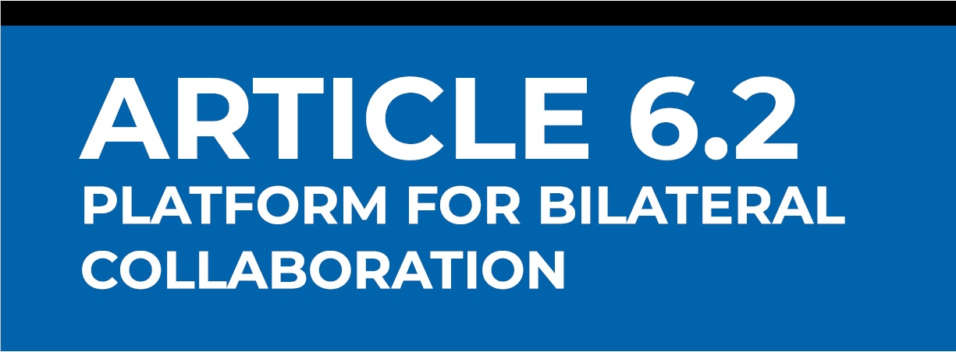


Activities Mapping and Integration with Global Platform
Vanuatu’s National ITMOs Registry
UNDP’s Article 6.2 Platform For Bilateral Collaboration
Data Sharing Mechanism
User Database (List of Users)
Project Database (List of Projects)
Project Status (Dynamic Status Update)
Project Document Database (Data Dump)
Key Activities of Article 6.2 Platform
User Registration (Mirror/user database from National Registry)
Project submission interface (all users)
Data, Document and report submission (all users)
Documentation and Status update
Document templates
Any others
Additional Activity of National Registry (Not linked with Platform)
Number of ITMOs Issued for project
Electronic Registry for ITMOs issuance, transfer and cancellation
National GHG Inventory
National Account of GHG emissions/Mitigation/ITMOs Balance

